Slide 1

CSE- 321
Software Engineering
Lecture : 01 Introduction
Fahad Ahmed
Lecturer, Dept. of CSE
E-mail: fahadahmed@uap-bd.edu

Slide 2
Lecture Outlines
What is Software?
Attributes of Good Software
Classification of Software
What is Software Engineering?
Importance of Software Engineering
Program vs Software Product
Software Engineering vs System Engineering
Software Process
Software Process Model
Key Challenges Facing Software Engineering
Software Engineering Ethics

Slide 3
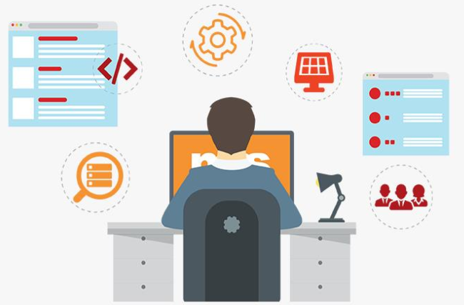
Are you a software Engineer ?

Slide 4
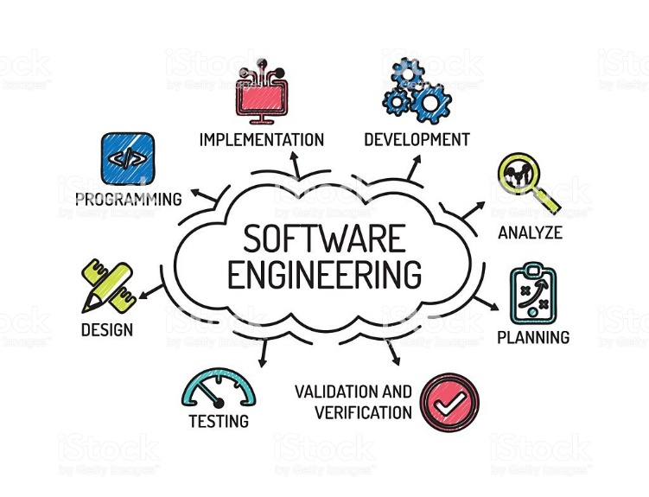
Software Engineering

Slide 5


Software Engineering
Software
Engineering
+
Product
Rules, Process, Manner

Slide 6
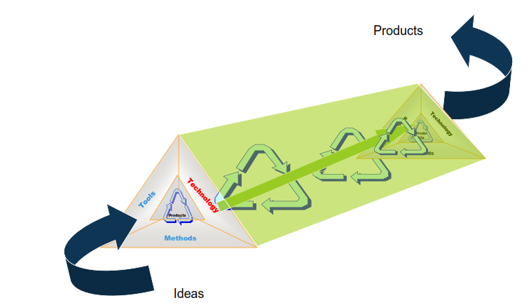
Software :: Product

Slide 7
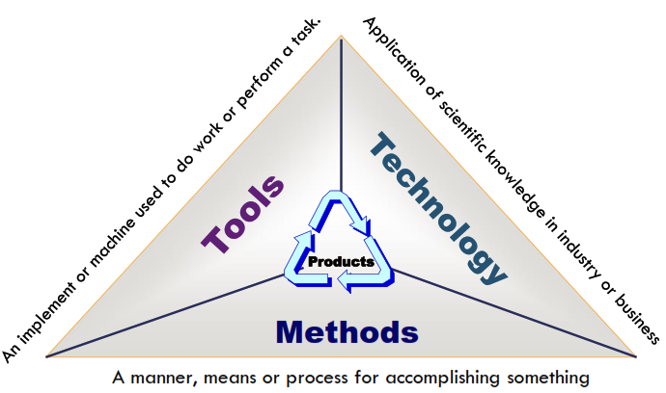
Software :: Product

Slide 8
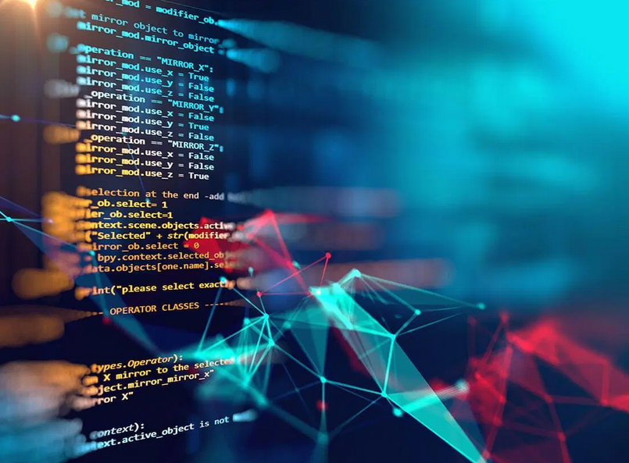
Software
What is software?

Slide 9
Software
What does Software mean?
A set of instructions
A program is an executable code
Executable computer programs and associated documentation
A program or set of programs containing instructions which provide desired functionality .

Slide 10

Software
What does Software mean?
The Institute of Electrical and Electronic Engineers (IEEE) defines software as a
Collection of computer programs, procedures, rules and associated documentation and data.

Slide 11
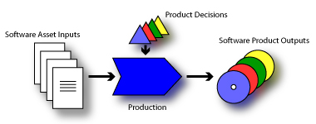
Software
What is software product?
Software, when made for a specific requirement is called software product.
Software products may be
Generic- developed to be sold to a range of different customers.
Customised (Bespoke) - developed for a single customer according to their specification.

Slide 12
Attributes of good software
Essential attributes of good software
Maintainability
Dependability and security
Efficiency
Acceptability
In addition to the above mentioned characteristics, robustness and integrity are also important.

Slide 13
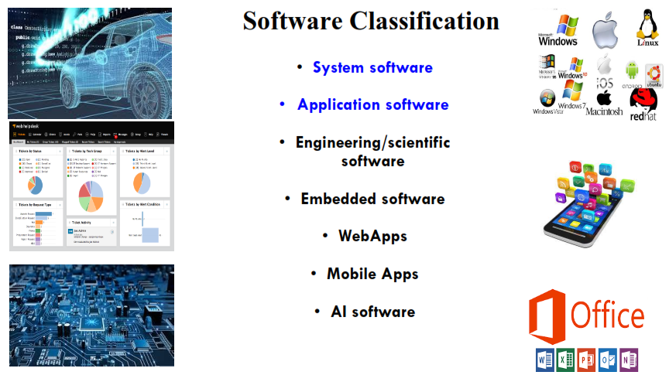
Classification of Software

Slide 14
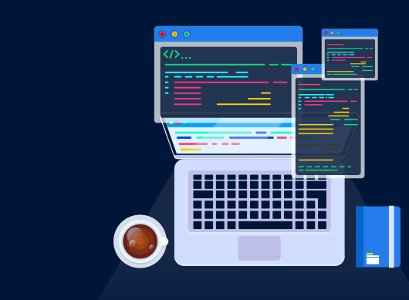
Software Engineering
Then,
what is Software
Engineering ?

Slide 15
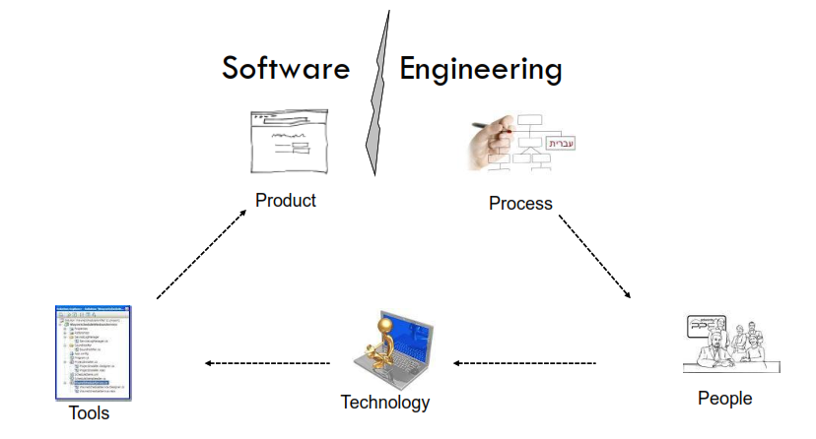
Software Engineering

Slide 16
Software Engineering
What is software engineering?
Software engineering is an engineering discipline that is concerned with all aspects of software production from the early stages of system specification through to maintaining the system after it has gone into use.
Software engineering is an engineering discipline whose focus is the cost effective development of the high quality software system.
IEEE, in its standard 610.12-1990, defines software engineering as the application of a systematic, disciplined, which is a computable approach for the development, operation, and maintenance of software.

Slide 17
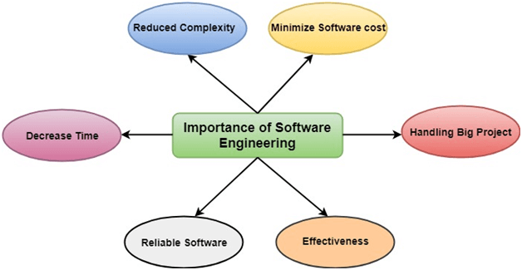
Importance of Software Engineering

Slide 18
Program vs Software Product
Program is a set of instruction related each other where as Software Product is a collection of program designed for specific task.
Programs are developed by individuals that means single user where as Software Product are developed by large no of users.
In program, there is no documentation or lack in proper documentation. In Software Product, Proper documentation and well documented and user manual prepared.
Development of program is Unplanned, not Systematic etc. but Development of Software Product is well Systematic, organized, planned approach.
Programs provide Limited functionality and less features where as Software Products provides more functionality as they are big in size (lines of codes) more options and features.

Slide 19
Software Engineering and System Engineering
What is the difference between software engineering and system engineering?
System engineering is concerned with all aspects of computer-based systems development including hardware, software and process engineering.
Software engineering is part of this more general process.
System engineers are involved in (overall) system specification, architectural design, integration, and deployment

Slide 20
Software process
What is a software process?
A software process is a sequence of activities that leads to the production of a software product.
Generic activities in all software processes are:
Software Specification
Software Development
Software Validation
Software Evolution

Slide 21

Thanks to All

